Slide 1
Group meeting
——Singscore
2019
Mora Lab
chengshu
11-06-2019

Slide 2
01
Background
02
Results
contents
03
Main R function
04
Conclusion

Slide 3
Background
PART 01
Why to use this method?

Slide 4
Background
Why to use this method?
Now, we can search so many methods used to score individual sample from all samples, such as :
PLAGE(2005), Z-score(2008), ssGSEA(2009), GSVA(2013)……
However, there are some disadvantages of using these methods:
Result in unstable scores in small data sets
Introduce biases from sample composition(various samples for different cancer types)
unstable scores: without linear fitting or other type fitting like normal distribution and so on

Slide 5
Background
Why to use this method?
However, there are some disadvantages of using these methods:
Result in unstable scores in small data sets
Introduce biases from sample composition(various samples for different cancer types)
Biases means the deviation of all measurements from the true value. Sometimes called “systematic error”.
Except for the considering features, there will exist other differences of samples between two or more conditions.

Slide 6
Background
Why to use this method?
To deal with these issues, the author developed a single sample scoring method, singscore.
Its associated R/Bioconductor package “singscore”:
https://bioconductor.org/packages/singscore

Slide 7
Results
PART 02

Slide 8
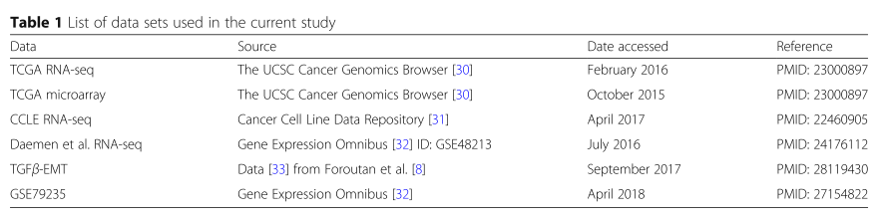
Results
workflows
Data
Data process
Data process:
“edgeR” used to calculate RPKM values;
all RNA-Seq data: remove low counts in mmost samples for example:
TCGA RNA-Seq data, RSEM abundance > 2 in more than 90% samples
Simulations
1 2 3 4
RSEM, an user-friendly software package for quantifying gene and isoform abundances from single-end or paired-end RNA-Seq data.
BMC Bioinformatics. 2011 Aug 4;12:323. doi: 10.1186/1471-2105-12-323.

Slide 9
Results
workflows
Data
“simulations”:
Stability:
500 TCGA samples used;
the Spearman’s rank correlation coefficient and concordance index
2. Power analysis and type I error
Data : Simulated RNA-seq data using methods from Law et al
(30 samples x 1000 genes, 2 biological conditions ( 15 samples in each group)with 30 differentially expressed genes (DEGs) between them)
Process : An inverse chi-Squared distribution used to model dispersion.
The library size was left constant at 1.1 × 107
This simulation was repeated 100 times, each time creating three gene sets of size 30 to represent the three scenarios : 50%DEGs(15 X 15) , 80%DEGs(24 X 6) , non-DEGs(30 non-DEGs)
Type I error is the proportion of simulations that non-DEGs sets tested positive, like false positive
Data process
Simulations
1 2 3 4

Slide 10
Results
workflows
“simulations”:
3. Gene-set recall
Data: RNA-seq data were again simulated using the method of Law et al, with NS = 30 and NG = 10,000, representing two biological conditions (NS =15 in each group) with 2000 DEGs (logFC or effect size = 1.1). Repeated this simulation 100 times, each time creating:
500 gene sets (of size 30) where 50% of genes were DE,
(ii) 500 gene sets where 80% of genes were DE,
500 gene sets where genes were randomly sam-pled, representing gene sets with no signal.
Scored samples and performed a t-test between the group scores to get p-values.
p-values from the 50% DEG set (500 p-values) and non-DEG set (500 p-values) were combined and adjusted for multiple hypothesis testing to produce estimated q-values [FDR = 0.05].
F1 score(Performance of these predictions was quantified) accounts for both the precision and recall of each method. This was repeated for p-values from the 80% DEG sets and non-DEG sets.
Data
Data process
Simulations
1 2 3 4

Slide 11
Results
workflows
Data
“simulations”:
4. Compare the computational time of each scoring method
randomly selected 10,000 gene sets from MSigDB signatures
all methods were used to score subsets of the TCGA breast cancer RNA-seq data with either 25 samples or 500 samples.
This was repeated 20 times to improve coverage of signatures on MSigDB and allow variance estimates for the computation times.
Data process
Simulations
1 2 3 4

Slide 12
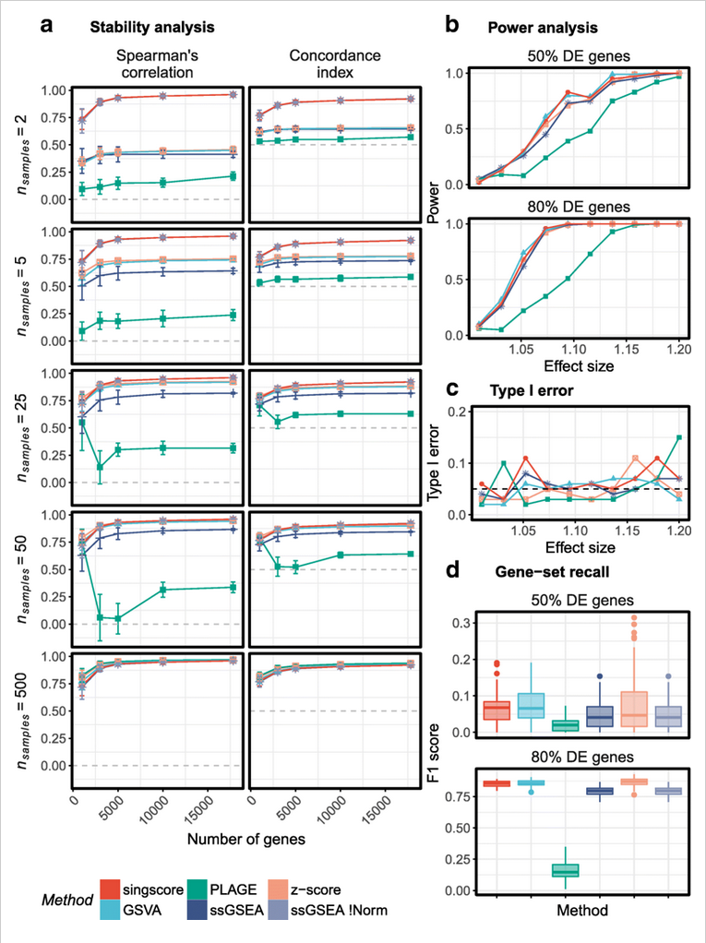
Results
1. highly stable
2. high power and gene-set recall ability
3. computationally fast

Slide 13
Main R functions
PART 03
R function in the package “singscore”

Slide 14
Main R functions
rankGenes()：gene expression dataset first needs to be ranked using the function which returns a rank matrix.
“SummarizedExperiment” class
simpleScore() ：This rank matrix along with the signatures are then passed to the function which returns a data.frame containing the scores for each sample.
Input data
Data matrix
Up-regulated gene sets
Down-regulated gene sets

Slide 15
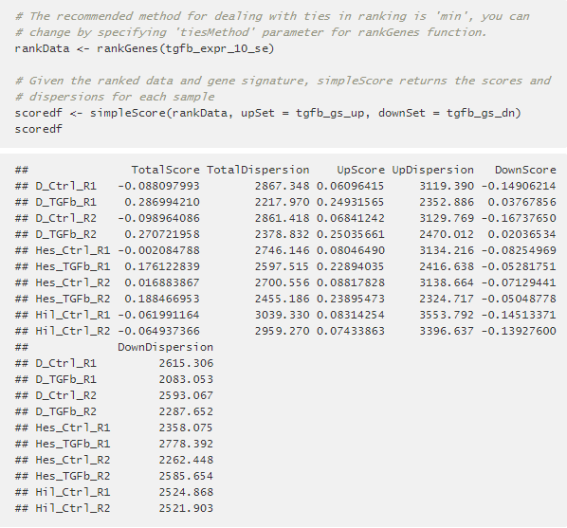
Main R functions
rankGenes()：gene expression dataset first needs to be ranked using the function which returns a rank matrix.
simpleScore() ：This rank matrix along with the signatures are then passed to the function which returns a data.frame containing the scores for each sample.
output data

Slide 16
Conclusion
PART 04

Slide 17
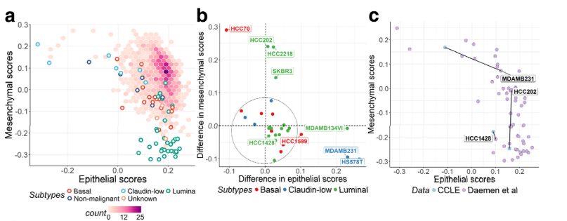
Application
Obtaining landscapes of molecular phenotypes
Comparing consistency of scores from independent data sets
Assessment of scores: beyond a single value

Slide 18
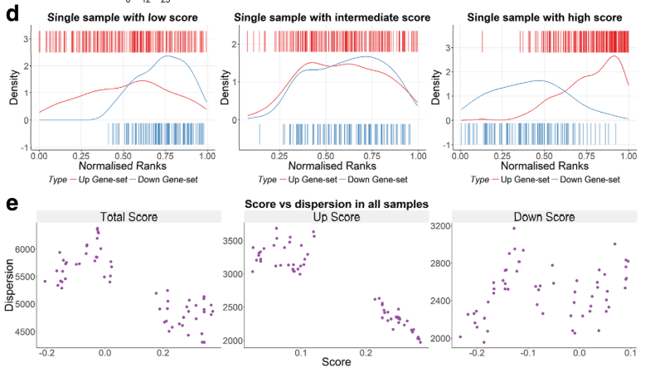
Application
Obtaining landscapes of molecular phenotypes
Comparing consistency of scores from independent data sets
Assessment of scores: beyond a single value

Slide 19
Conclusion
Advantages
1. Easily be applied on any high throughput transcriptional data from microarray or RNA-seq experiments.
2. Stable scores across a range of sample sizes and numbers of measured genes
3. A non-parametric, rank-based, and truly single sample method

Slide 20
Thank you

